Slide 1
Smartphone-based Fall Detection
Ariel Keller
6/4/2012

Slide 2
1. Introduction
Falls are:
The leading cause of hospitalization of elderly [3].
The sixth cause of death for those over 65 [3].

Slide 3
1. Introduction
As current population ages, we expect to soon have a higher percentage of elderly population than ever before [6].

Slide 4
1. Introduction
Falls and fall detection are of immediate importance.

Slide 5
2. Motivations
High demand
Problems with current systems
Many false positives & thus poor specificity

Slide 6

3. Related Work
Acceleration magnitude is measured by a “root-sum-of-squares” (RSS) value…
RSS=
RSS values are often expressed in gs
g is acceleration due to gravity, i.e. 9.8 m/s²

Slide 7
3. Related Work
What is the “anatomy” of a fall? [3]
Free fall
RSS value falls below 1g, approaching 0g.
Impact
On impact, the RSS value spikes, usu. to above 3g.
Inactivity

Slide 8
3. Related Work
Thresholds—a common fall detection approach. [2]
Lower fall threshold (LFT)
Typically somewhere between 0g and 1g.
Upper fall threshold (UFT)
Usually set at or above 3g.

Slide 9
3. Related Work
Detecting a fall using thresholds:
RSS drops below LFT (Free fall)
RSS spikes above UFT (Impact)
Check for inactivity
Used by some systems, like [1]. It helps decrease false positives.

Slide 10
3. Related Work
Using gyroscopes for posture information [3].
Gyroscopes use more energy than accelerometers [3].

Slide 11
3. Related Work
Abbate et al. [2] proposed a unique approach for decreasing false positives…
Some ADLs (activities of daily living) exhibit peaks similar to falls.
Under the threshold technique, these ADLs are likely to register false positives.

Slide 12
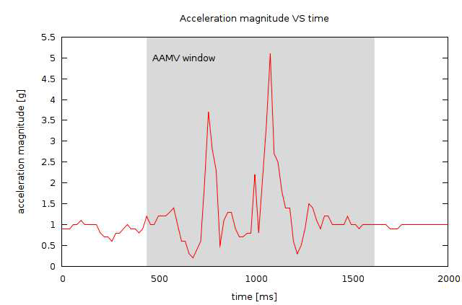
3. Related Work
Real fall:
Image 3.1 From [2].

Slide 13
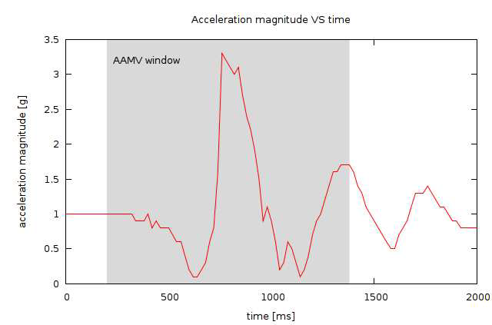
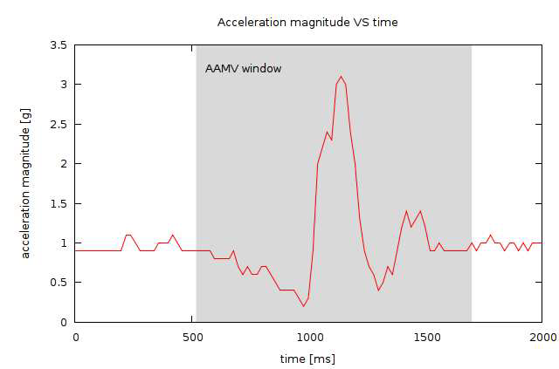
3. Related Work
Class A ADL: Class A ADL:
(Elastic surface) (Soft surface)
Image 3.1 From [2].

Slide 14
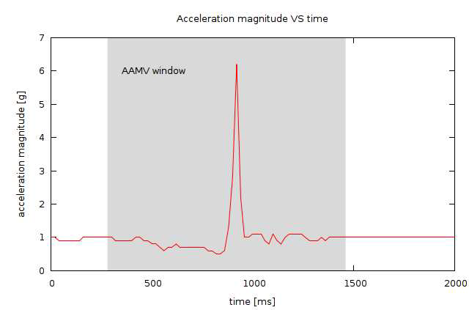
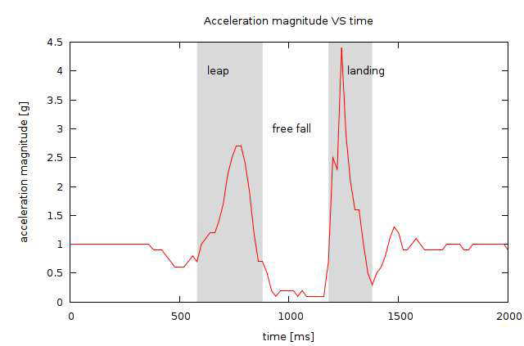
3. Related Work
Class B ADL: Class C ADL:
(Medium/hard surface) (Jumping)
Image 3.1 From [2].

Slide 15
3. Related Work
Abbate et al. defined algorithms to filter out class A, B and C ADLs
Average Acceleration Magnitude Variation (AAMV)
Free Fall Interval (FFI)
Free Fall Average Acceleration Magnitude (FFAAM)

Slide 16

3. Related Work
Equation 3.1 From [2].
AAMV should be higher for real falls than for class A and B ADLs

Slide 17

3. Related Work
Equation 3.2 From [2].
Class C ADLs have a longer FFI and smaller FFAAM than do real falls.

Slide 18
4. Proposed Approach & Present Status
Our initial algorithm [1]:
Basic threshold approach
Check for inactivity
Too many false positives.

Slide 19
4. Proposed Approach & Present Status
Chose to implement the algorithms from [2] to filter out fall-like ADLs
Goal
Improved specificity
Comparable sensitivity

Slide 20
4. Proposed Approach & Present Status
Device: mobile phone
Ubiquitous
Rather inexpensive
Easy to “wear”
Equipped to call for help
Platform: Android
Open source
Written in Java

Slide 21
4. Proposed Approach & Present Status
Current status:
An implementation of our algorithm is programmed, complete with the addition of the new algorithms from [2]
Working Android app

Slide 22
4. Proposed Approach & Present Status
The app was originally designed using source code from Gonzales [1]
How the app works:
Enter app
Press “Start Monitoring” button
May leave app and continue to use phone
Service may be explicitly stopped by user

Slide 23
4. Proposed Approach & Present Status
Service uses an event listener to call onSensorChanged() method when a change in acceleration is detected.
Sampling rate determines how frequently we take accelerometer readings.

Slide 24
4. Proposed Approach & Present Status
Four sampling rates: NORMAL, UI, GAME, FASTEST
Rates of 200ms, 60ms, 20ms, and 10ms respectively.
App uses a 200ms sampling rate.

Slide 25
4. Proposed Approach & Present Status
We do not know the extent of the impact of a higher sampling rate on battery life.
Need to try different sampling rates and study their effect on the battery.

Slide 26
4. Proposed Approach & Present Status
We also do not know the effect of the sampling rate on the accuracy of the algorithms.

Slide 27
4. Proposed Approach & Present Status
The new algorithms from [2] were designed for a 20ms sampling rate.
It may be necessary to increase the sampling rate for them to work properly.
Additional research is necessary to discern the effect of the sampling rate on algorithm’s accuracy.

Slide 28
5. Evaluation
Should use a standard set of trials in testing.
This facilitates comparison of different fall detection systems.

Slide 29
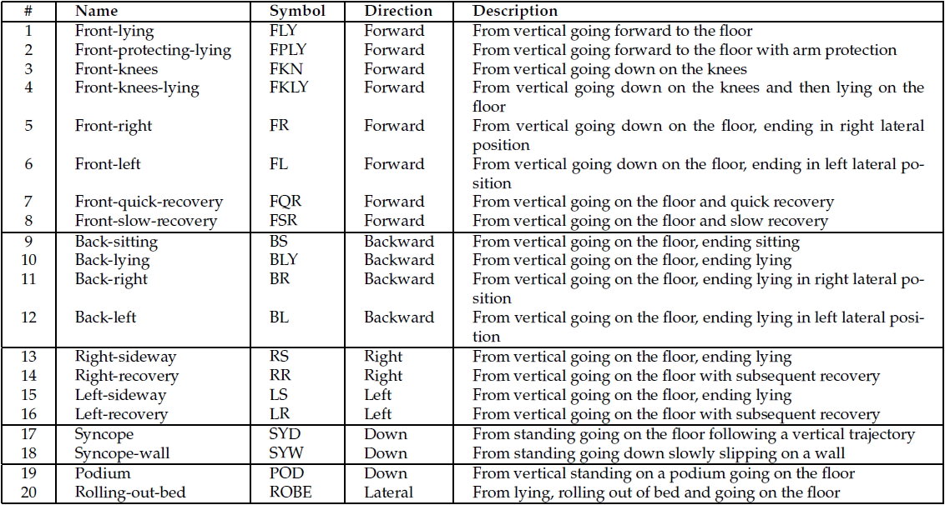
5. Evaluation
Table 5.1 Actions to be detected as falls. From [3].

Slide 30
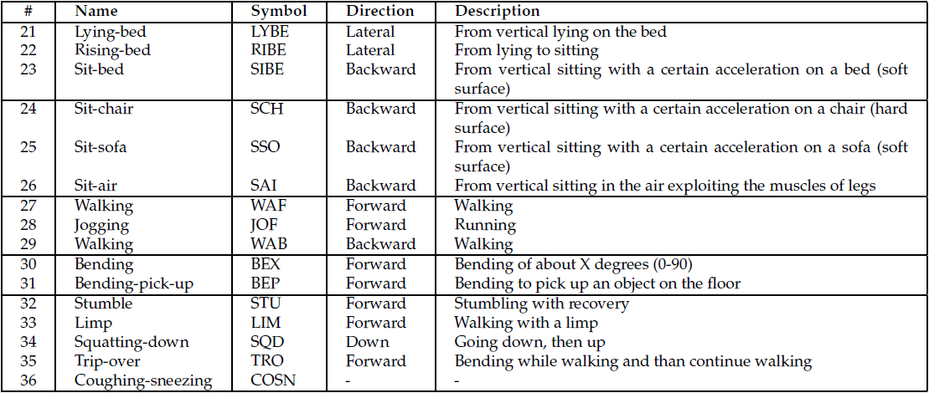
5. Evaluation
Table 5.2 Activities that must not be detected as falls. From [3].

Slide 31
5. Evaluation
It is important to have real-world testing in addition to simulations [4].

Slide 32
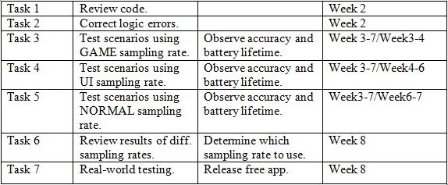
6. Timeline

Slide 33
7. References
[1] I. J. D. Gonzales. Fall detection using a smartphone. Master’s thesis, Gjovik University College, 2010-2011. Available in http://www.stud.hig.no/~090285/falldetection.pdf
[2] S. Abbate, M. Avventui, G. Cola, P. Corsini, J. Light, and A. Vecchio. Recognition of False Alarms in Fall Detection Systems. CCNC, IEEE, Italy, 2011, p. 23-28.
[3] S. Abbate, M. Avventui, P. Corsini, J. Light, and A. Vecchi. Monitoring of Human Movement for Fall Detection and Activities Recognition in Elderly Care Using Wireless sensor Network : a Survey, Wireless Sensor Networks: Application-Centric Design, Merrett, G. V., Tan & Y.K., 2010, p. 1-20.
[4] Bagalà F, Becker C, Cappello A, Chiari L, Aminian K, et al. (2012) Evaluation of Accelerometer-Based Fall Detection Algorithms on Real-World Falls. PLoS ONE 7(5): e37062. doi:10.1371/journal.pone.0037062

Slide 34
7. References
[5] A.K. Bourke, P. van de Ven, M. Gamble, R. O’Connor, K. Murphy, E. Bogan, E. McQuade, P. Finucane, G. ÓLaighin, J. Nelson. Evaluation of waist-mounted tri-axial accelerometer based fall-detection algorithms during scripted and continuous unscripted activities. Journal of Biomechanics - 16 November 2010 (Vol. 43, Issue 15, Pages 3051-3057, DOI: 10.1016/j.jbiomech.2010.07.005)
[6] B. Brown. An Acceleration Based Fall Detector: Development, Experimentation, and Analysis. Summer Undergraduate Program in Engineering Research at Berkeley (SUPERB), University of California, Berkeley, 2005. http://www.eecs.berkeley.edu/~eklund/projects/Reports/GarrettFinalPaper.pdf

